Slide 1
KeyWord Spotting on edge devices
Using Neural Networks
Meeta Malviya
180070034
Guide - Prof. Rajbabu Velmurugan

Slide 2
What is Keyword Spotting?
Keyword spotting deals with the identification of target keywords or phrases in utterances that triggers appropriate action to be taken once identified.
Eg. Spotting the wakeup command for smart home devices.
“Hello Google”, “Alexa”

Slide 3
Motivation for the project
Critical for enabling speech based user interactions on smart devices
Traditional methods are hard to train and computationally expensive
Real-time response and high accuracy requirement applications

Slide 4
What we gain?
Major advantages are -
Lower Latency
Reduced Network Overhead
Increased Privacy
Robust from cyber attacks and network failure

Slide 5
Challenges going forward
The major challenges of implementing DL on microcontrollers are :-
Limited computational resources
Limited memory footprint
Limited execution time required- lower latency
Energy Constraints - Lower power consumption requirement

Slide 6
Related Work - Neural Networks
RNN (recurrent neural networks)
Outperform HMM
Large Latency
DNN (Deep neural networks)
Outperform RNN - higher accuracy, lower size and latency
ignores local temporal and spectral correlation
CNN (convolutional neural networks)
Higher accuracy and takes correlation in account
they ignore long term temporal dependencies

Slide 7
Related Work - Neural Networks
CRNN (Convolutional Recurrent Neural Networks)
Advantages of RNN and CNN
Does not learn relationship between successive time and frequency steps
DS-CNN (Depthwise Separable CNN)
Lower number of computations to be done
Vanishing gradient problem
Deep Residual Network (ResNet)
Compressible and good accuracy
Vanishing gradient problem - skip connections
Notes:
Converts 3d convolution into 2d and 1d convolutions

Slide 8
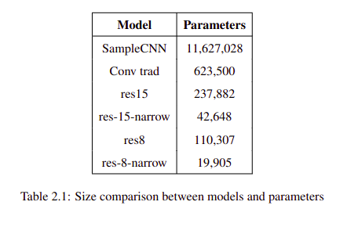
Size Comparison for Different Models

Slide 9
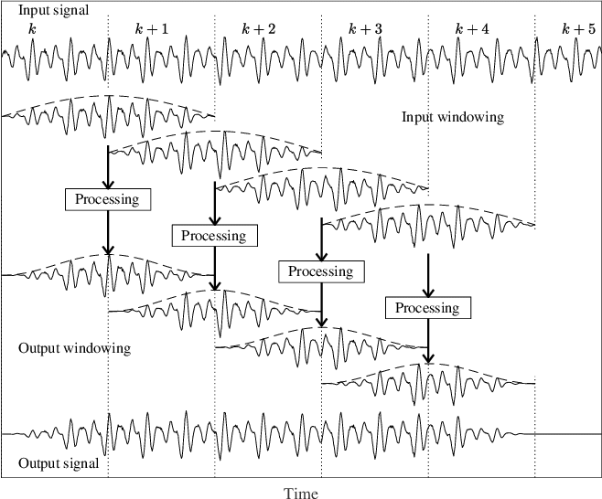
Feature Extraction
Windowing of speech signal
Calculation of MFCC coefficients
https://www.researchgate.net/figure/Illustration-of-input-and-output-windowing-with-overlap-add-synthesis-in-a-speech_fig1_330871136

Slide 10
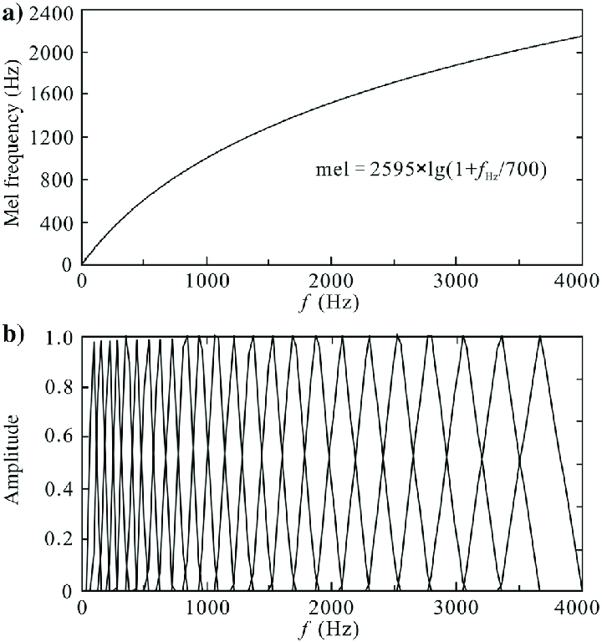
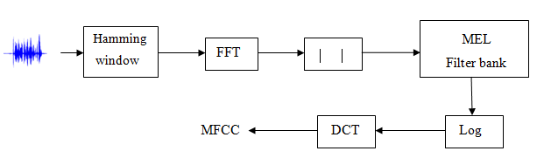
MFCC Computations
https://www.researchgate.net/profile/Christophe-Rosenberger/publication/257365356/figure/fig2/AS:297528441491462@1447947716655/Calculation-process-of-MFCC-coefficients.png
https://www.researchgate.net/profile/Tao-Xie-22/publication/315501403/figure/fig2/AS:757175785893888@1557536183946/a-Mel-frequency-scale-versus-normal-frequency-b-In-total-24-triangular-window.png

Slide 11
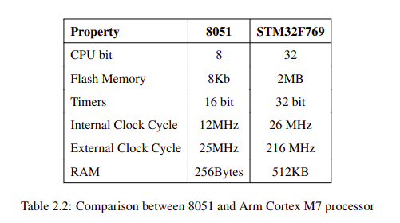
Comparison Between 8051 and STM32F769

Slide 12
DataSet
The dataset that we are using is ‘Google speech commands dataset'. The dataset consists of 1,05,829 utterances of 35 words
We have trained our model on 7h 44m 51s worth data for 10 output classes namely “Yes”, “No”, “Up”, “Down”, “Left”, “Right”, “On”, “Off”, “Stop”, and “Go”.
Each wav file was of 1s in length and the sample data is encoded as linear 16b single channel PCM values at 16 kHz.

Slide 13
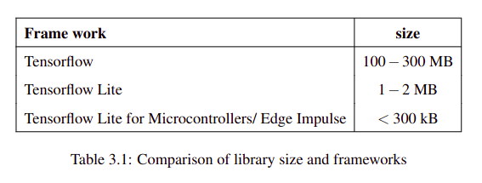
Neural Network in Microcontrollers
Tensorflow Lite for Microcontrollers
CMSIS -NN library
Edge Impulse
Notes:
CMSIS enables consistent device support and simple software interfaces to the processor and its peripherals

Slide 14
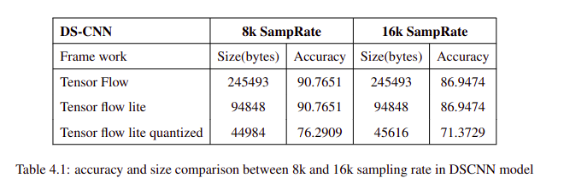
Results- Changing Sampling Rate
Changing sampling rate for DS CNN model

Slide 15
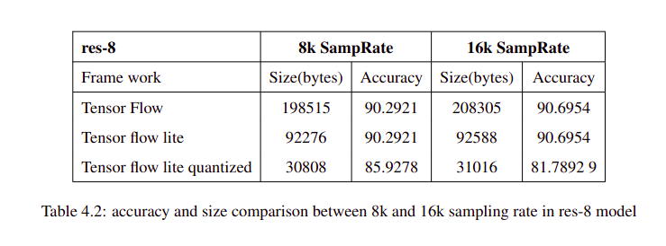
Results- Changing Sampling Rate
Changing sampling rate for res-8 model

Slide 16
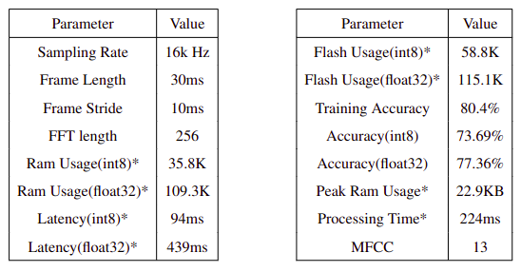
Results - Changing MFCC Parameters
Output of the neural network for the given configuration of 30 ms frame length and 10 ms frame stride

Slide 17
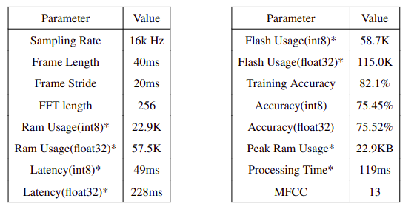
Results - Changing MFCC Parameters
Output of the neural network for the given configuration of 40 ms frame length and 20 ms frame stride

Slide 18
Work Done
Literature review
Replication and understanding of the work done
Running experiments with neural network for higher accuracy
Creating and training deployable models on edge impulse
Running offline testing code (replication and verification of prev work)
Combining code for offline testing and microphone api of board for real time testing (in progress)

Slide 19
Conclusions
Neural Networks outperform traditional methods of keyword spotting algorithms
Trade of between complexity (accuracy) and memory footprint
Microcontrollers can be used for KWS
Higher accuracies can be obtained by carefully tuning the training parameters

Slide 20
Future Scope
Further quantization of models parameters in int4 and int2
More robust by adding background noise
Detecting phrases for more meaningful commands

Slide 21
Thank You

